Slide 1
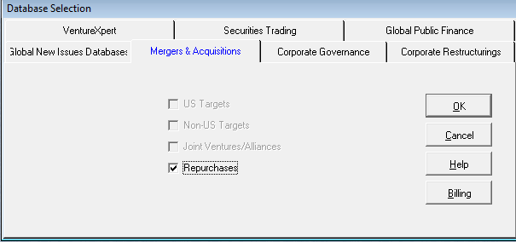

Slide 2
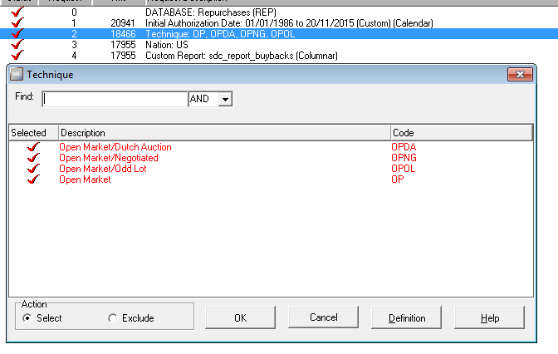

Slide 3
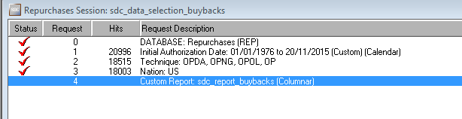
Since 1976

Slide 4
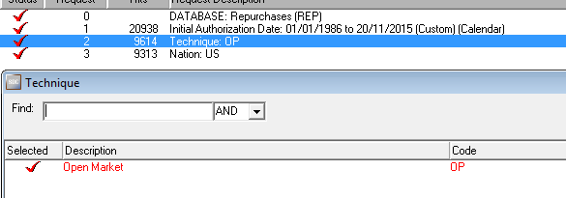
OLD DATA (Only OP)

Slide 5
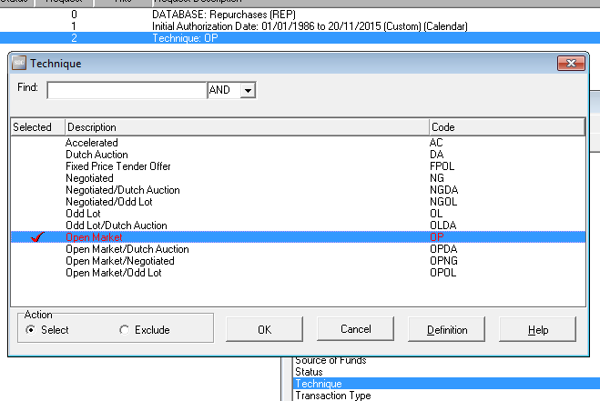

Slide 6
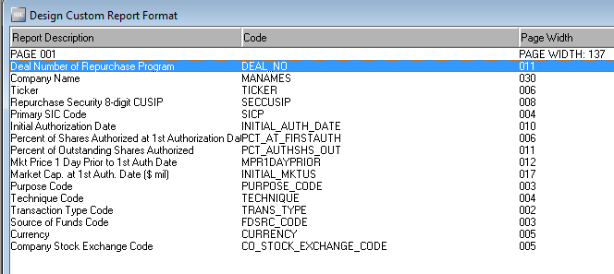

Slide 7
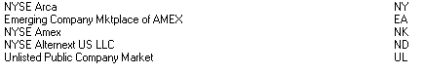
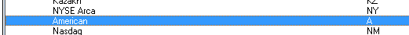
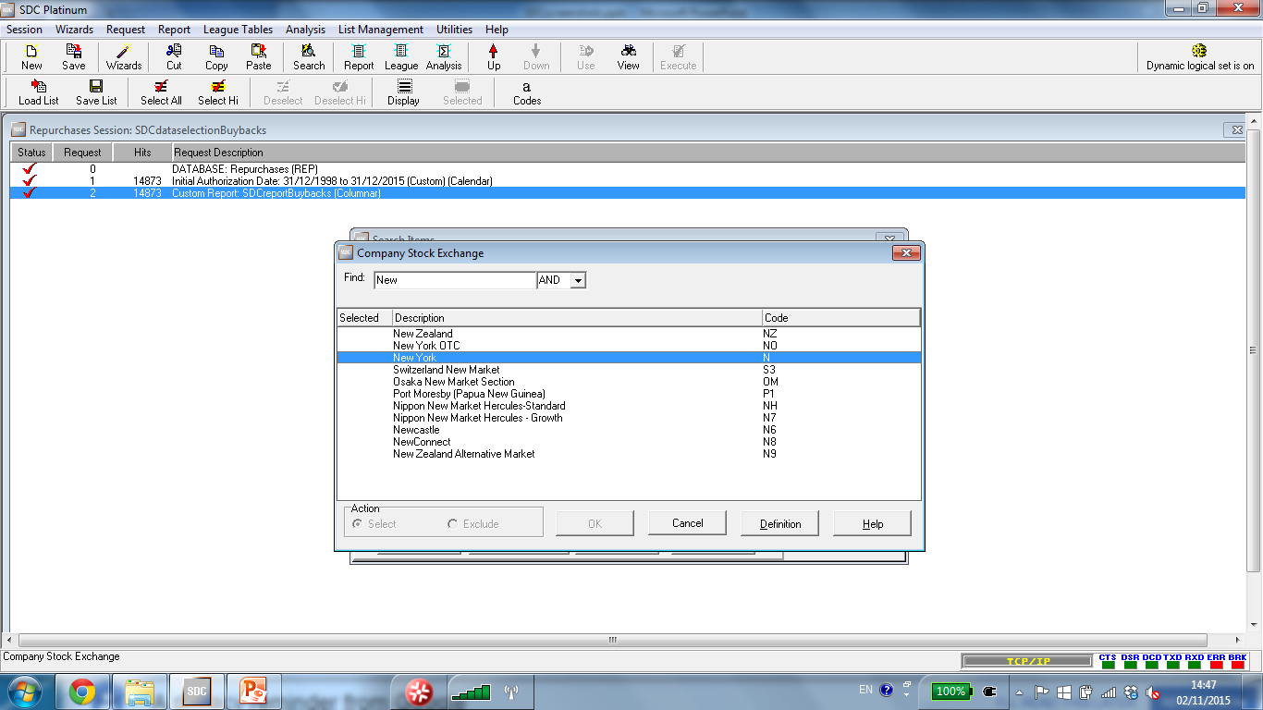
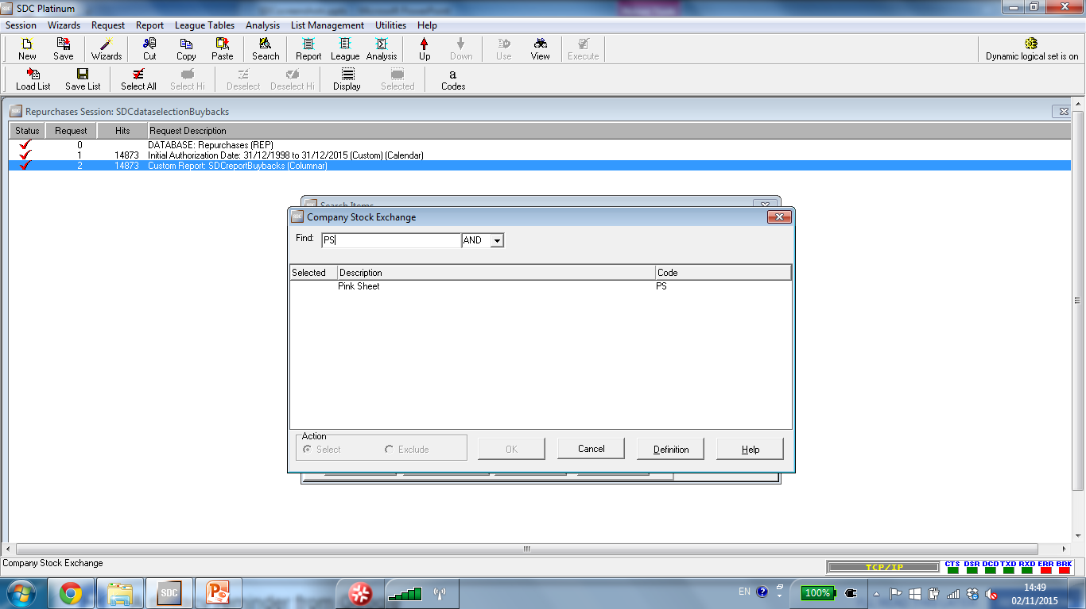


Slide 8
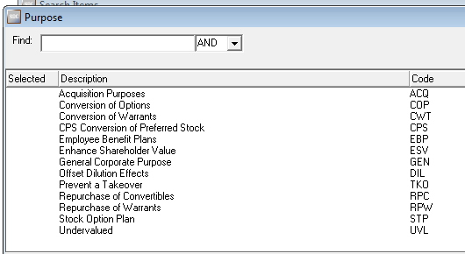

Slide 9
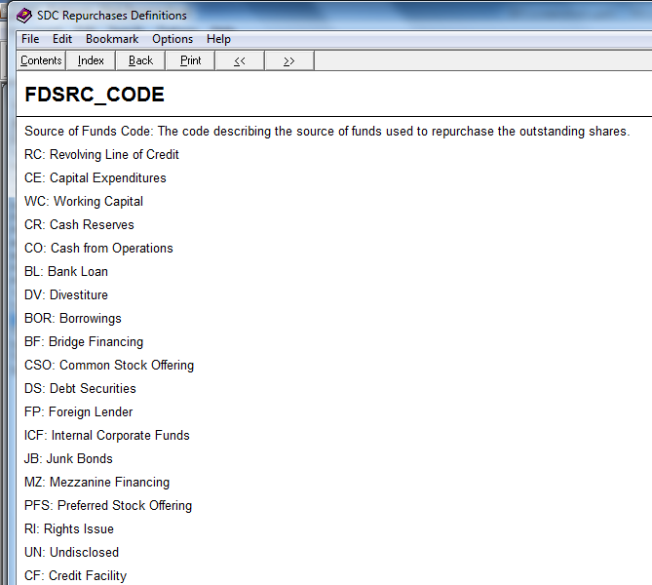

Slide 10
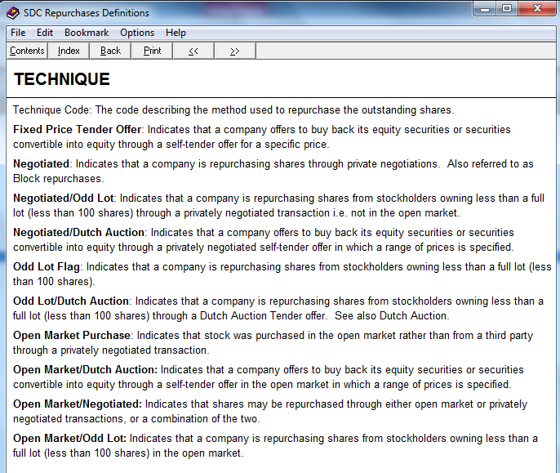

Slide 11
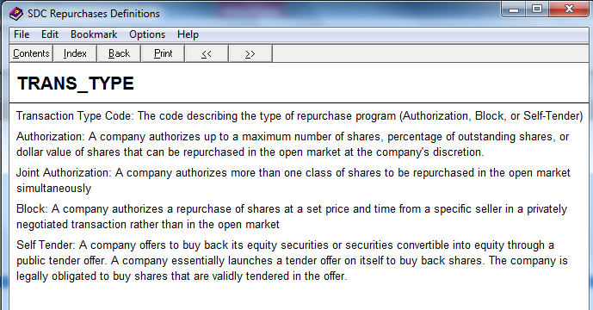

Slide 12
M&A database

Slide 13
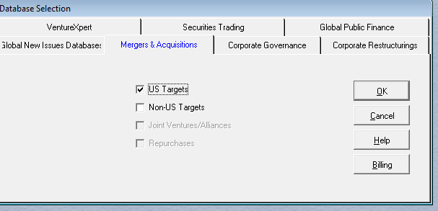

Slide 14
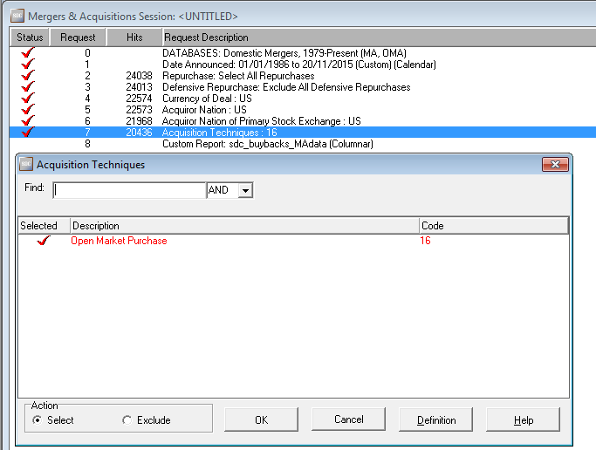

Slide 15
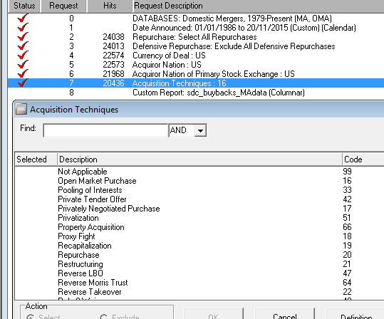

Slide 16
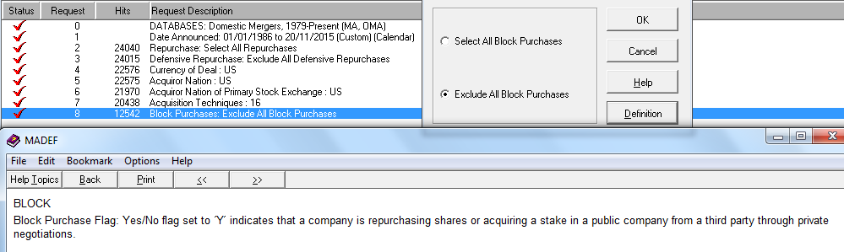
Remove Block Purchases
(Notice 2 extra events: SDC is updated daily)

Slide 17
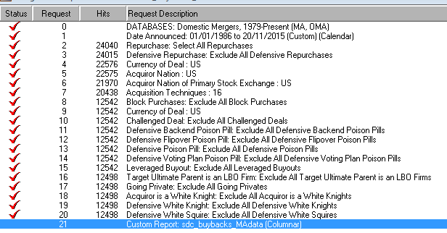
Add more flags just in case

Slide 18
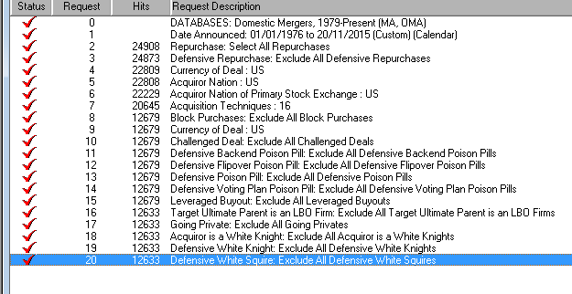
Since 1976

Slide 19
RANK_MENUACQTECH
Acquisition Techniques: Acquisition technique code number, e.g. 8 (Divestiture):
A yes/no flag which indicates significant characteristics about the transaction:
Alliance Flag: When ‘Y’ is flagged it indicates that two companies exchange minority stakes of equal value in each other as a part of the formation of a strategic alliance.
Acquiror Includes an ESOP: Yes/No flag set to 'Y' where acquiror includes an Employee Stock Ownership Plan of the target company. See also EMP (Employee Participation Flag), where the acquiror includes employees of the target company.
Acquiror Includes Employees: Yes/No flag set to 'Y' where acquiror includes employees of the target company. See also ESOP, where acquiror includes and Employee Stock Ownership Plan of the target company.
Acquiror Includes Management: ‘Y’ indicates that the management of the target company is taking an equity interest in the target company as part of the acquisition.
Acquiror is an Investor Group: ‘Y’ indicates that the acquiror is an investor group.
Acquiror is White Knight Flag: ‘Y’ indicates that an acquiror has made a friendly offer or has reached an agreement to acquire a target that is currently the subject of a hostile or unsolicited offer by another company; acquiror is a White Knight. A ‘Squire’ is very similar to a ‘White Knight’, the only difference being that the ‘Squire’ only acquires a blocking minority stake and does not acquire a majority. The result is the same however; the hostile bid is thwarted.
Asset Swap: ‘Y’ indicates a transaction in which assets are being swapped in exchange for assets.
Auction: When a private sale is going to take place, regardless of whether the ultimate parent is public or the deal is a privatization, and the seller is soliciting multiple offers simultaneously for the asset/business it is attempting to sell. Auctions are generally sealed bids made on a specific date where the bidders do not know each other’s offer amounts.
Bankruptcy Flag: Yes/No flag set to 'Y' when the target company is bankrupt or goes bankrupt during the transaction.
Bear Hug Flag: Yes/No flag is set to ‘Y’ to indicate that the bidder has submitted a letter to an executive and/or board of a company with an unsolicited or unexpected offer to acquire all or part of its business. A bear hug letter typically includes an attractive offer (in terms of price and other features) that the directors of the target company must consider or risk a shareholder protest. Thomson Reuters will classify the transaction as a Bear Hug if a press release or trade article refers to the offer as such or if an unsolicited approach was made with a premium of at least 20% over the target’s closing stock price the day prior to the announcement.
Buyin/Management Buyout: Yes/No flag set to ‘Y’ for a highly leveraged transaction where the target’s existing management alongside incoming management, backed by one or more institutional investors, lead or initiate a buyout deal.
Collar Deal Flag: ‘Y’ indicates that the exact consideration offered in a stock swap transaction is based on a set range which is usually determined by the acquiror’s average closing stock price prior to the close of the deal. For example, if the acquiror’s average closing stock price prior to the close fell into the high end of the range, the target shareholders would receive the number of shares defined in the collar.
Concession: ‘Y’ indicates that a grant of property especially by a government for a period of at least 25 years. Concessions can include the usage of railways as well as the administration of an airport. Usually, all revenues earned by the entity holding the concession are entirely theirs.
Creeping Purchase Flag: Yes/No flag set to 'Y' when the acquiror has made creeping purchases; that is, accumulates a majority interest through a series of stake purchases, either through private or open market transactions.
Deal Started as Unsolicited Flag: Yes/No flag set to "Yes" when acquiring company makes an offer for another company without prior negotiations.
Debt Restructuring Flag: Yes/No flag set to 'Y' when the transaction is part of, or the target is undergoing, a debt restructuring whereby debt securities or debt forgiveness is exchanged for common/ordinary equity or securities exchangeable into common/ordinary equity.
Debt Tender Offer Flag: Yes/No flag set to 'Y' when a tender offer is launched for the target’s non-convertible debt securities (including non-convertible preferred securities). A debt tender offer is a formal offer of determined duration to acquire a public company's debt securities made to debt holders. Debt Tender Offers are not included in TR’s published M&A Rankings.
Divestiture Flag: ‘Y’ indicates that the deal is a divestiture meaning there is a loss of majority control; the parent company is losing a majority interest in the target or the target company is disposing of assets.
Dutch Auction Tender Flag: 'Y' indicates that a company offers to buy back its equity securities or securities convertible into equity through a self-tender offer in which a range of prices is specified. Shareholders indicate the price at which they would sell their shares. The final offer price is determined at the expiration of the offer by purchasing shares at the lowest possible price necessary in order to obtain the desired number of shares.
Equity Carveout Flag: Yes/No flag set to 'Y' when the transaction is an Equity Carveout. In an Equity Carveout, the new company’s shares are distributed or sold to the public via an IPO. Equity Carveouts are tracked only if they represent 100% or more of the unit, subsidiary division or other company. However an Equity Carveouts of any size is tracked if it is a Privitization. Equity Carveouts are not included in TR’s published M&A Rankings.
Exchange Offer Flag: Yes/No flag set to 'Y' where a public company offers to exchange new securities for its equity securities outstanding, securities convertible into equity, or non-convertible debt securities. Also includes deals in which an existing loan is replaced with a new facility during a debt restructuring. Exchange Offers are not included in TR’s published M&A Rankings.
Failed Bank Flag: Yes/No flag set to 'Y' where the target company is a failed bank.
Financial Acquiror Flag: ‘Y’ indicates that the acquiror is a financial company (buyout firm, venture capital company, merchant bank, commercial bank, etc.) and the target’s main industry is non-financial and it must be acquired for financial rather than strategic reasons.
Formation of a Limited Partnership Flag: Yes/No flag set to 'Y' where a limited partnership was set up as a result of the transaction.
Four Way Merger: ‘Y’ indicates the combination of four separate companies. In some cases the merger may result in the existence of a newly created fifth entity, whereby the four original companies may either cease to exist or become subsidiaries of the newly formed entity.
Going Private Flag: ‘Y’ indicates that a private acquiror (‘private’ meaning that none of the acquiror’s ultimate parentage is public either) is acquiring a public target and upon completion, it will become a private company.
Institutional Buyout: Yes/No flag set to ‘Y’ for a highly leveraged transaction where one or more institutional investors act together to lead or initiate a buyout deal.
Joint Venture Flag: Yes/No flag set to 'Y' when the transaction involves the formation of a joint venture where existing assets are contributed by both parties. This is only a small portion of transactions covered in the separate JOINT VENTURES DATABASE.
LBO + Employee Stock Plan: The acquisition of a company by a newco established for the purpose by the company’s employees participating by way of an Employee Share Ownership scheme and backed by one or more institutional investors.
LBO + Management + Employee: Yes/No flag set to ‘Y’ for a highly leveraged transaction where employees in conjunction with existing target management, backed by one or more institutional investors, lead or initiate a buyout deal.
Leveraged Buyout Flag: ‘Y’ indicates that the transaction is a leveraged buyout. An "LBO" occurs when an investor group, investor, or firm offers to acquire a company, taking on an extraordinary amount of debt, with plans to repay it with funds generated from the company or with revenue earned by selling off the newly acquired company's assets. TR considers an LBO if the investor group includes management or the transaction is identified as such in the financial press and a majority interest of the company is acquired.
Liquidation Flag: Yes/No flag set to 'Y' where transaction was part of a liquidation plan.
Litigation Flag: Yes/No flag set to 'Y' where the players launched litigation as a result of the transaction.
Litigation Delay Flag: Yes/No flag set to 'Y' where the litigation launched by the players caused a delay in the normal progress of the transaction.
Loan Modification Flag: Yes/No flag set to ‘Y’ when an existing facility required and received a 100% vote amendment and either an extension of maturity or reduction in debt as a result of a restructuring. Loan Modifications are not included in TR’s published M&A Rankings.
Management Buyin: Yes/No flag set to ‘Y’ for a highly leveraged transaction where incoming management, backed by one or more institutional investors, lead or initiate a buyout deal.
Management Buyout: Yes/No flag set to ‘Y’ for a highly leveraged transaction where existing target management, backed by one or more institutional investors, lead or initiate a buyout deal.
Mandatory Offering Flag: ‘Y’ indicates that an acquiror reach a certain ownership level in the target and by law is required to make an offer to acquire the remaining interest in the target. This item applies to international deals only and is subject to each country’s takeover laws.
Merger of Equals Indicator: ‘Y’ indicates that the target and acquiror in a stock swap transaction have approximately the same market capitalization, and the ownership of the new entity will be owned roughly 50/50 by the target and acquiror shareholders. Both companies should also have close to equal representation on the board of the new company.
Open Market Purchase Flag: 'Y' indicates that stock was purchased in the open market rather than from a third party through a privately negotiated transaction or public securities offering. The transaction must be a Stake Purchase or a Repurchase (see Deal Type).
Pooling of Interests Flag: ‘Y’ indicates that the acquiror is using the "pooling of interests" accounting method in a stock swap transaction. It is a tax-free exchange of stock whereby the balance sheets of both companies are added together.
Private Tender Offer Flag: ‘Y’ indicates a formal offer of determined duration to acquire a private company's shares made to equity holders. Private tenders are only valued by TR if the number of the private companies outstanding shares is known.
Privately Negotiated Purchase Flag: ‘Y’ indicates that a company is repurchasing shares or acquiring a stake in a public company from a third party through private negotiations.
Privatization Flag: ‘Y’ indicates a government or government controlled entity sells shares or assets to a non-government entity. Privatizations include both direct and indirect sales of up to a 100% stake to an identifiable buyer and floatations of stock on a stock exchange. The former is considered an M&A transaction and will be included in the quarterly rankings; the latter will not.
Property Acquisition: Indicates that the transaction involves the acquisition of a completed building or a portfolio of completed buildings.
Proxy Fight Flag: Yes/No flag set to 'Y' where the hostile bidder launched a proxy fight for control of the target company's board.
Recapitalization Flag: Yes/No Flag set to 'Y' where deal is a recapitalization, or deal is part of a recapitalization plan, in which the company issues a special one-time dividend in the form of cash, debt securities, preferred stock, or assets, while allowing shareholders to retain an equity interest in the company.
Repurchase Indicator: Yes/No flag set to "yes" when a company buys back its shares in the open market or in privately negotiated transactions or a company's board authorizes the repurchase of a portion of its shares.
Restructuring Flag: Yes/No flag set to 'Y' when the transaction is part of, or the target is undergoing, a restructuring whereby the debt on the balance sheet is reduced through a bankruptcy/distressed sale, a tender offer or exchange offer for existing debt securities, or a loan modification. A transaction is defined as a restructuring only if one or more of the following conditions have been met: (i) the company has publicly confirmed that it has retained a restructuring advisor, has filed for bankruptcy/receivership protection, has publicly confirmed plans to restructure its debt, or has gone into default or has missed a coupon payment, (ii) an S&P/Moody issuer, issue, or probability of default rating of CCC+/Caa1 or below either before or in reaction to the announcement of the restructuring plan, (iii) a debt-for-debt exchange offers where debt holders will exchange their bonds at a discount, or (iv) a credit facility or debt security carries a yield of at least 1,000 bps over US Treasuries.
Reverse LBO Flag: Yes/No flag set to 'Y' where a company that was acquired in an leveraged buyout subsequently made an initial public offering.
Reverse Morris Trust: Indicates that the transaction was structured under US legislation which allows for a tax-free transfer of a subsidiary or division to a third party.
Reverse Takeover Flag: ‘Y’ indicates a merger in which the acquiring company offers more than 50% of its equity as consideration offered to the target company resulting in the target company becoming the majority owner of the new company.
Rule 9 Waiver: This is also known as a Mandatory offer waiver. This is the opposite of the Mandatory Offer flag. Under certain circumstances the requirement to make a mandatory offer is waived and the acquiror is not required to launch an offer for the remaining outstanding shares in the target. Reverse takeovers will often involve a Rule 9 waiver.
Rumor Flag: ‘Y’ indicates that the transaction is currently or originally began as a rumor. Even if both parties later confirm the deal, rumor remains ‘Y.’
Sale Leaseback: Indicates that the transaction is a sale and leaseback transaction.
Scheme of Arrangement flag: ‘Y’ indicates a reorganization of a company’s capital structure that will be binding on shareholders. A scheme is carried out in several steps, which entails that the court order a meeting for shareholders affected; majority shareholder approval must be received; and, the scheme is referred back to the court for confirmation.
Self-Tender Flag: ‘Y’ indicates when a company offers to buy back its equity securities or securities convertible into equity through a tender offer. A company essentially launches a tender offer on itself to buy back shares.
Spinoff Flag: ‘Y’ indicates a "spinoff," which is the tax free distribution of shares by a company of a unit, subsidiary, division, or another company's stock, or any portion thereof, to its shareholders. TR tracks spinoffs of any percentage.
Splitoff Flag: Yes/No flag set to 'Y' when the transaction is a splitoff. A splitoff is defined as the redemption of shares in an existing company, in exchange for shares in a newly created one. Splitoffs of any percentage are tracked. Splitoffs are included in TR’s published M&A Rankings.
Stock Swap Flag: ‘Y’ indicates a transaction in which the acquiring company exchanges equity in itself for equity in the target. The acquiror must be acquiring at least 50% of the target’s equity or be acquiring the remaining interest up to 100% of the target’s equity, and at least 50% of the consideration offered must be in the form of equity.
Sweeping Purchase Flag: Yes/No flag set to 'Y' where acquiror makes stake purchase(s) of all available shares with intention of gaining control.
Tender/Merger Flag: Yes/No flag set to 'Y' when a tender offer is launched to acquire control of a company, and the offer is followed by a merger agreement in which the acquiring company agrees to purchase the remaining shares not tendered under the offer.
Tender Offer Flag: Yes/No flag set to 'Y' when a tender offer is launched for the target. A tender offer is a formal offer of determined duration to acquire a public company's shares made to equity holders. The offer is often conditioned upon certain requirements such as a minimum number of shares being tendered.
Three Way Merger Flag: ‘Y’ indicates the combination of three separate companies. In most cases the merger results in the existence of a newly created fourth entity, whereby the three original companies may either cease to exist or become subsidiaries of the newly formed
Two-Tier Transaction Flag: ‘Y’ indicates that the acquiror is offering a different (often higher) consideration for the shares needed to gain control of the target company. Then the acquiror makes an offer or agreement to acquire the remaining shares for a separate consideration.
Two Step Spinoff: ‘Y’ indicates a deal where the planned spinoff of a company’s remaining shares is preceded by an initial public offering (IPO) of that company’s shares (please note we don’t track the IPO in the M&A database). The plans to spin off the remaining shares must be announced at the same time that the IPO is announced by the parent company. The IPO will generally be for a small stake in the subsidiary, usually 10 to 20%, and the spinoff will therefore be for the remaining interest not distributed via the IPO. The spinoff must take place within 18 months of the IPO in order to be considered a Two Step Spinoff. This data item is valid on deals announced beginning in 1995.
White Squire Flag: ‘Y’ indicates when the target company attempts to thwart an unsolicited or hostile bid by selling a block (less than a majority) of shares (usually convertible preferred with special voting rights) to a friendly third party. A ‘Squire’ is very similar to a ‘White Knight’, the only difference being that the ‘Squire’ only acquires a blocking minority stake and does not acquire a majority. The result is the same however; the hostile bid is thwarted.

Slide 20
